Slide 1




Dynamic Coordination of Train Operations and Energy Assets for Grid Support and Peak Shaving
Presenter: Hamed Darbandi

Slide 2

Inputs
Train
Travel time duration
Flexible travel times
Battery
(Dis)charging rate
Capacity
PV generation
Time/Date
Weather condition
Track Speed limits, Gradient
Time-table
Train specs

Slide 3
Capabilities
With focus on a substation (or hub)
Peak Shaving
Energy Management
Management by Profile Steering
Battery state of charge
Power Generation Profile
Solar production
Regenerative energy
Decrease power limit or Extend time
Adapting to time-table
Driving strategy (adjusted to Peak Shaving)

Slide 4
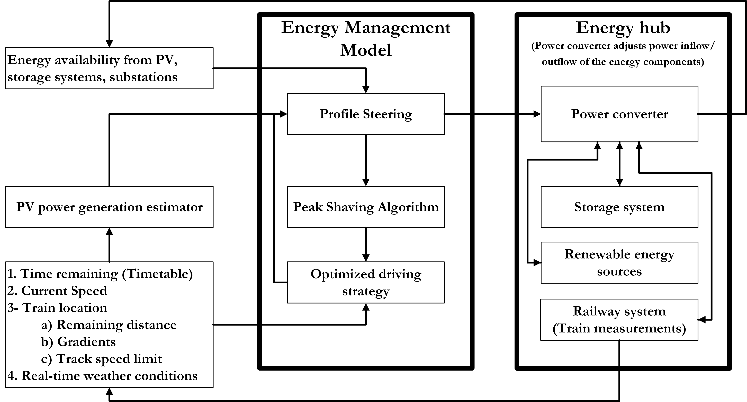
Flowchart

